Slide 1

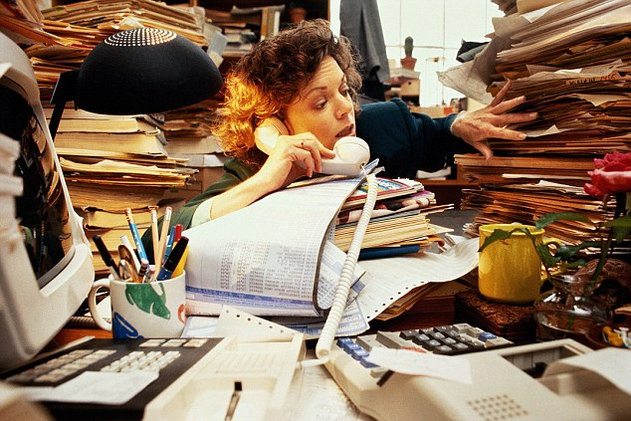
Time Tracking solutions
Got a Sec?
Why didn’t you write that down?

Slide 2
Management feeds on numbers
They use these numbers to justify headcount
YOU are one of those headcounts
Can you explain to management how you spent your time today?
Do you want to exchange a walk-on part in the war for a lead role in a cage?

Slide 3
Promotions and layoffs associated with productivity

Slide 4
Compare and contrast these employees
First group has GotASec working for them
Second group does not
This is what management sees
 | Group 1 | Group 2
Busy | Yes | yes
Numbers to back this up | Yes | No
Indispensable? | Yes | No

Slide 5
Understanding today’s complex world of the future is a little like bees living in your head
But, there they are
Future trends show Japanese working 25 hour days with ample documentation
Future trends show Americans working for the Japanese
Good numbers
GotASec tracks time
busy

Slide 6
Introducing Gotasec
A very comfortable collar

Slide 7
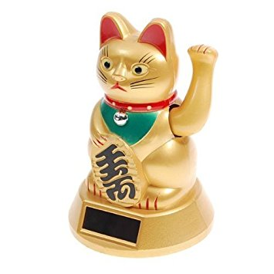
Monitor walk-ups and random questions
Just put the gotasec on your desk
And GotaSec will track walkup times
for you
Example report:
May 1 2017 09:05 60 minutes
May 1 2017 11:30 30 minutes
May 1 2017 13:00 45 minutes
May 1 2017 14:00 20 minutes
May 1 2017 16:45 90 minutes

Slide 8
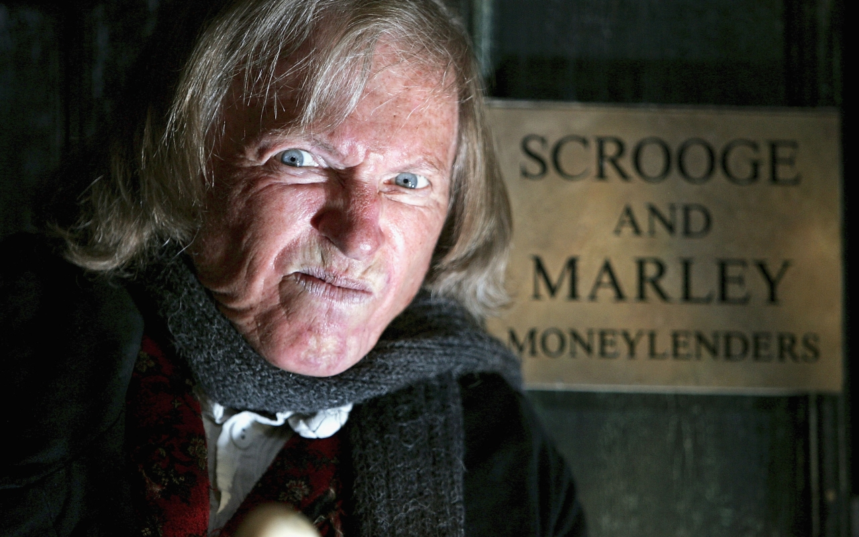
Your boss will be impressed (slightly)

Slide 9
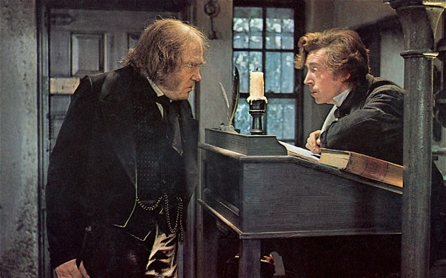
You won’t get fired (yet)

Slide 10
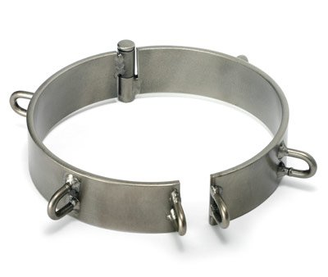
Management version coming soon

Slide 11
GotASec components
Connect to BLE
Sync time
Monitor for visitors
Send message via BLE when visitor leaves
Accept data via BLE
Publish data via mqtt to the Cloud
Subscribe mqtt topic
Generate report
iPhone App Bluefruit
Receive Publish
store same
Mqtt client
Arduino Uno
io.particle.com

Slide 12
Time to Nerd out!
Code highlights
Includes AdaFruit libraries, Time, and Timezone
Asks for ctime at startup (seconds since epoch) to set the “clock”
Time code shamelessly stolen from their github page
Timezone required otherwise timestamps are 6 hours off
Bluefruit initialization code shamelessly stolen from their github page
Uses iPhone app ‘bluefruit’ to receive data then publish via mqtt to io.adafruit.com
Uses a photovoltaic sensor to “see” people and a blue LED lights when they are present
These will be the “eyes” of the Lucky Cat in version 2.0

Slide 13
Time to Nerd out!
Code snippets
Serial.println("Please enter ctime in form T123467890");
// wait long enough for dumb human to enter time then process same.
delay(10000);
processSyncMessage();
<snip!>
// A double factory reset for the Bluetooth cuz once ain’t never enough!
if ( ! ble.factoryReset() ) {
// try twice before giving up
if ( ! ble.factoryReset() ) {
error(F("Couldn't factory reset")); } }

Slide 14
Time to Nerd out!
Code snippets
// we want to output a 1 if "someone is there" and a 0 if "no one is there" val = check_it();
delay(1000);
oldval = val;
val = check_it();
// gotta be the same both times or else it’s a false positive
<snip!>
startTime = now();
startTime = usCentral.toLocal(startTime);
// wait for them to go away
while ( check_it() == 0) {
delay(1000); } // went dark, they left.

Slide 15
Time to Nerd out!
Code snippets
endTime = now();
endTime = usCentral.toLocal(endTime);
duration = endTime - startTime;
output = String(month(startTime)) + "/" + String(day(startTime)) + "/" + \ String(year(startTime)) + " " + String(hour(startTime)) + ":" + \ String(minute(startTime)) + " : " + String(duration) + "\n";
<snip!>
delay(3000);
ble.print(output);
delay(3000);

